Slide 1
Looking back: How far have we come? Rétrospective : où en sommes-nous ?
E²M²: Ecological and Epidemiological Modeling in Madagascar
Hotel Cyperus
Andasibe, Madagascar
May 2025

Slide 2
● Programming
● Data
● Models
● Research Development
Thursday: “Modeling Different Types of Data”
● Hike at VOI
● Spatial Analysis and Visualization
● Spatial Analysis Tutorial
● Model Comparison
Saturday: R Bootcamp
Intro to R and R Studio
Data Manipulation in R
Exploring and Visualizing Data in R
Wednesday: “Fitting Models to Data”
● Refining Research Questions for Modeling
● Reading a Model-Focused Research Paper
● Model Fitting in Practice
● Model Fitting Tutorial
● Model Fitting with Epidemic Cards
Sunday: “Travel Day”
● Travel MBC → Andasibe
● Downloading packages
● Night walk at VOI
Friday: “Using Models in Practice”
● Model Comparison Tutorial
● Phylogenetic Analysis
● Phylogenetic Analysis Tutorial
● Research Seminar
● Model Telephone
Tuesday: “Exploring Types of Models”
● Linear Regression
● Linear Regression Tutorial
● Mechanistic Modeling
● Mechanistic Modeling Tutorial
● Formulating Research Questions
● Epidemic Cards Game
Monday: “Getting Started with the Basics”
● Data and Models
● Formulating Research Questions
● Simple Mathematics and Statistics
● Dynamical Fever
Saturday: Travel
Monday: “Sharing Your Work”
● Final student presentations

Slide 3
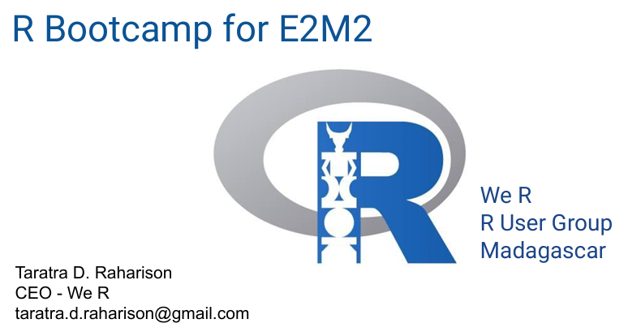
Saturday: R Bootcamp
Intro to R and R Studio
Data Manipulation in R
Exploring and Visualizing Data in R

Slide 4
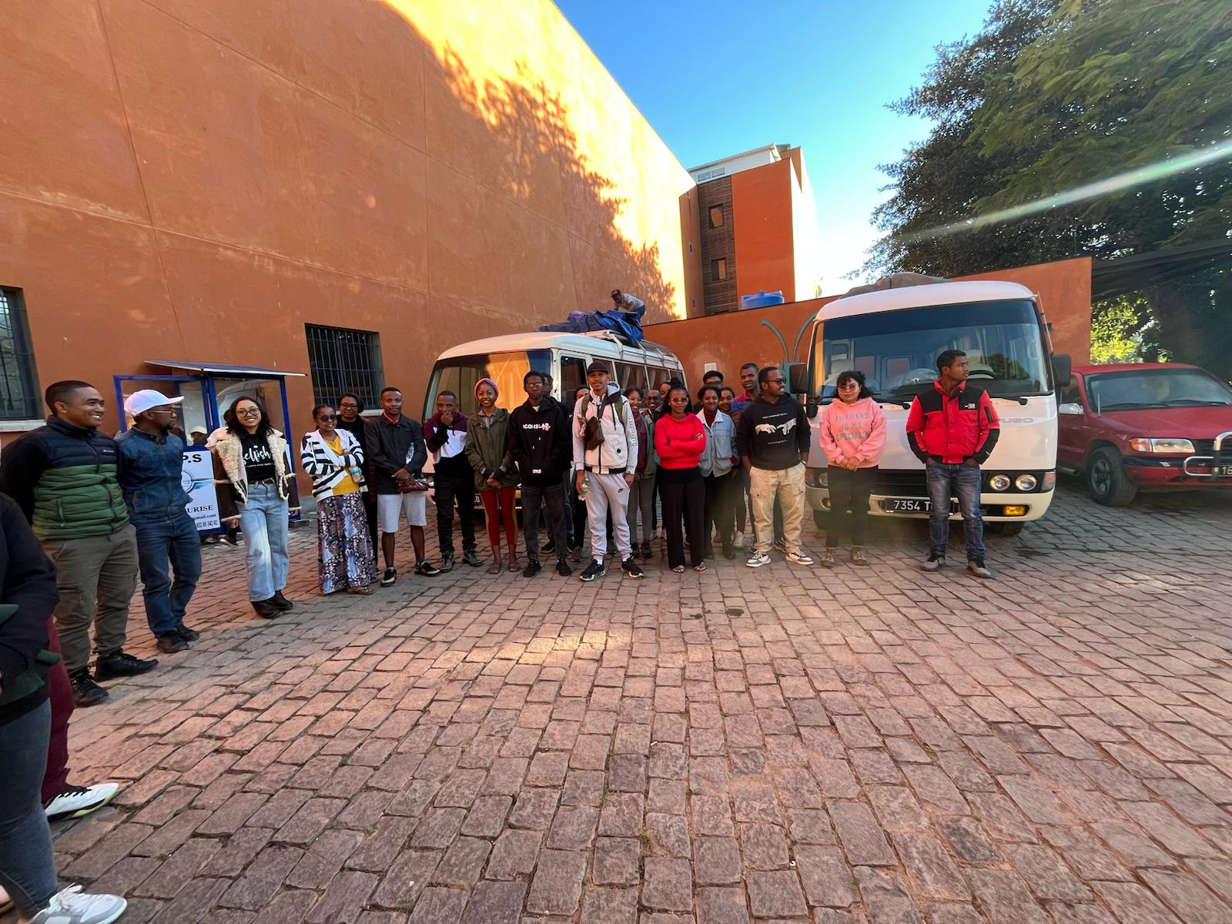
Saturday: R Bootcamp
Intro to R and R Studio
Data Manipulation in R
Exploring and Visualizing Data in R
Sunday: “Travel Day”
● Travel MBC → Andasibe
● Downloading packages
● Night walk at VOI
Monday: “Getting Started with the Basics”
● Data and Models
● Formulating Research Questions
● Simple Mathematics and Statistics
● Dynamical Fever

Slide 5
What is science? C’est quoi la science?
Monday: “Getting Started with the Basics”
● Data and Models
● Formulating Research Questions
● Simple Mathematics and Statistics
● Dynamical Fever

Slide 6
What is science? C’est quoi la science?
Monday: “Getting Started with the Basics”
● Data and Models
● Formulating Research Questions
● Simple Mathematics and Statistics
● Dynamical Fever
the systematic observation of natural events and conditions in order to discover facts about them and to formulate laws and principles
l'observation systématique des événements et des conditions naturelles afin de découvrir des faits à leur sujet et de formuler des lois et des principes fondés

Slide 7
Monday: “Getting Started with the Basics”
● Data and Models
● Formulating Research Questions
● Simple Mathematics and Statistics
● Dynamical Fever
What are data? Quelles sont les données?

Slide 8
What are data? Quelles sont les données?
Monday: “Getting Started with the Basics”
● Data and Models
● Formulating Research Questions
● Simple Mathematics and Statistics
● Dynamical Fever
evidence to support a claim
preuves à l'appui d'une réclamation

Slide 9
Monday: “Getting Started with the Basics”
● Data and Models
● Formulating Research Questions
● Simple Mathematics and Statistics
● Dynamical Fever
What is a model? C’est quoi un modèle?

Slide 10
Monday: “Getting Started with the Basics”
● Data and Models
● Formulating Research Questions
● Simple Mathematics and Statistics
● Dynamical Fever
What is a model? C’est quoi un modèle?
an abstract representation of a phenomenon
une représentation abstraite d'un phénomène

Slide 11
Monday: “Getting Started with the Basics”
● Data and Models
● Formulating Research Questions
● Simple Mathematics and Statistics
● Dynamical Fever
What is a model? C’est quoi un modèle?
an abstract representation of a phenomenon
une représentation abstraite d'un phénomène
Statistical
Statistique
Mechanistic
Mécaniste

Slide 12
Monday: “Getting Started with the Basics”
● Data and Models
● Formulating Research Questions
● Simple Mathematics and Statistics
● Dynamical Fever
What is a model? C’est quoi un modèle?
an abstract representation of a phenomenon
une représentation abstraite d'un phénomène
Statistical
Statistique
Mechanistic
Mécaniste
Correlation
Corrélation
Causation
Causalité
What?
Que?
How?
Comment?

Slide 13
Monday: “Getting Started with the Basics”
● Data and Models
● Formulating Research Questions
● Simple Mathematics and Statistics
● Dynamical Fever
Formulating research questions Formuler des questions de recherche
Statistical: What factors explain the geographic distribution of plague infection in
Rattus rattus in Madagascar?
Mechanistic: Can the Malagasy black rat (Rattus rattus) population independently maintain
transmission of the plague bacterium, Yersinia pestis?

Slide 14
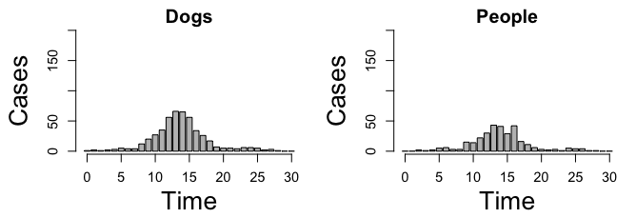
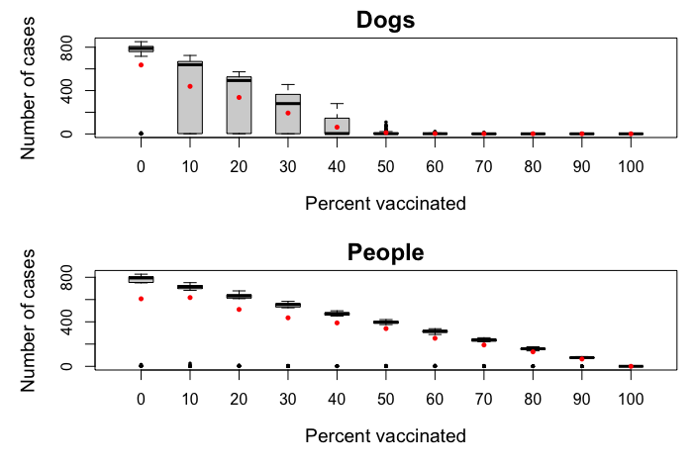
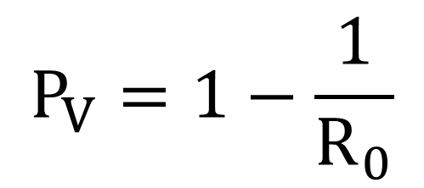
Monday: “Getting Started with the Basics”
● Data and Models
● Formulating Research Questions
● Simple Mathematics and Statistics
● Dynamical Fever
Dynamical Fever Fièvre dynamique
$$P_{V}=1−\frac{1}{R_{0}}$$

Slide 15
Saturday: R Bootcamp
Intro to R and R Studio
Data Manipulation in R
Exploring and Visualizing Data in R
Sunday: “Travel Day”
● Travel MBC → Andasibe
● Downloading packages
● Night walk at VOI
Tuesday: “Exploring Types of Models”
● Linear Regression
● Linear Regression Tutorial
● Mechanistic Modeling
● Mechanistic Modeling Tutorial
● Formulating Research Questions
● Epidemic Cards Game
Monday: “Getting Started with the Basics”
● Data and Models
● Formulating Research Questions
● Simple Mathematics and Statistics
● Dynamical Fever

Slide 16
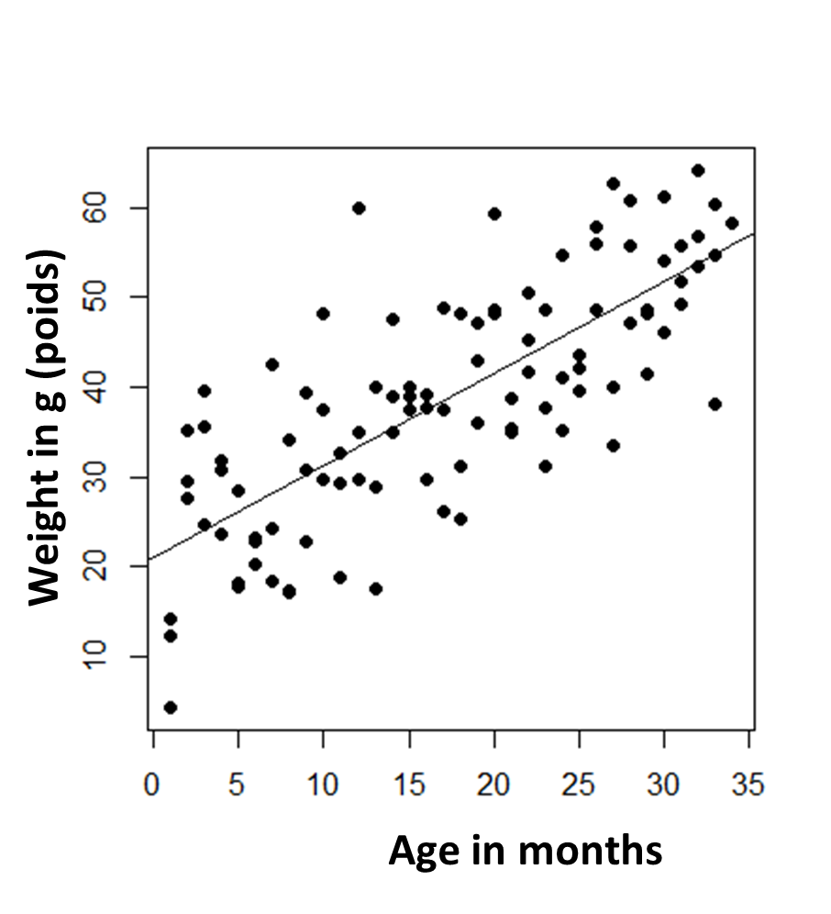
Tuesday: “Exploring Types of Models”
● Linear Regression
● Linear Regression Tutorial
● Mechanistic Modeling
● Mechanistic Modeling Tutorial
● Formulating Research Questions
● Epidemic Cards Game
Linear Regression Régression linéaire
y = α + βx + ε

Slide 17

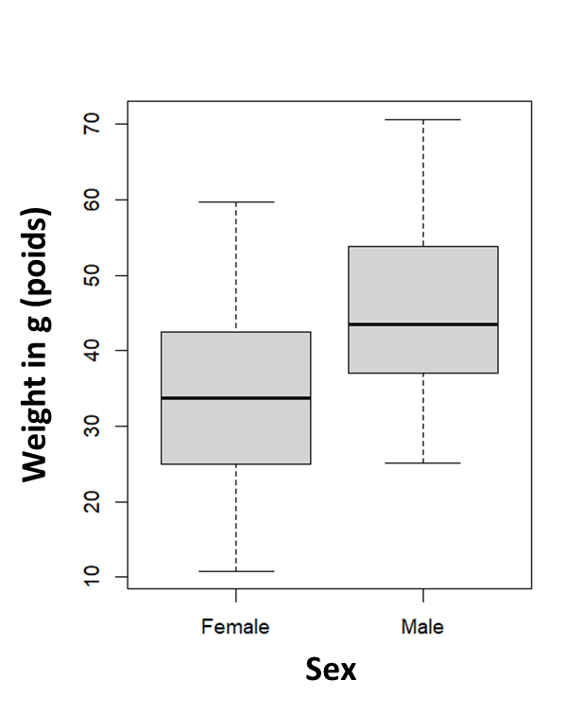
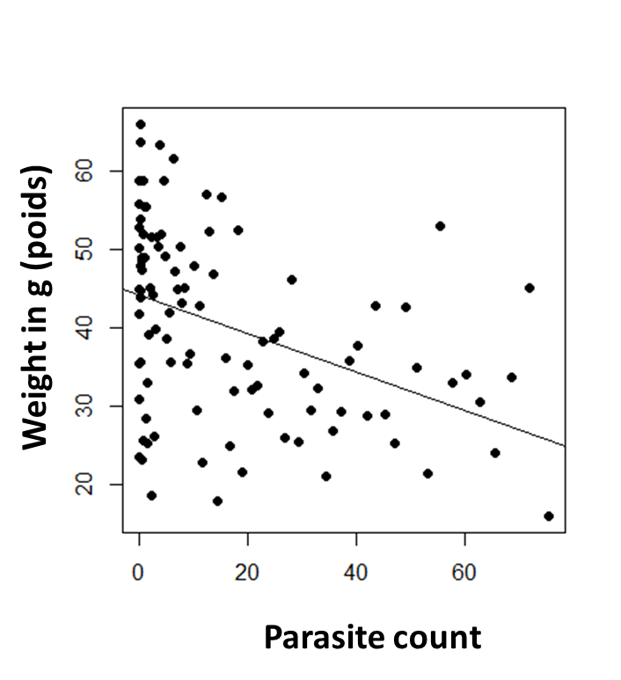
Tuesday: “Exploring Types of Models”
● Linear Regression
● Linear Regression Tutorial
● Mechanistic Modeling
● Mechanistic Modeling Tutorial
● Formulating Research Questions
● Epidemic Cards Game
Linear Regression Régression linéaire
lm(taille ̴age+sexe+GIparasites, data)

Slide 18
Tuesday: “Exploring Types of Models”
● Linear Regression
● Linear Regression Tutorial
● Mechanistic Modeling
● Mechanistic Modeling Tutorial
● Formulating Research Questions
● Epidemic Cards Game
Intro to Compartmental Models Introduction aux modèles compartimentés
Population
Madagascar
(N)
deaths
N_{t+1}=births*N_{t}-deaths*N_{t}

Slide 19
Tuesday: “Exploring Types of Models”
● Linear Regression
● Linear Regression Tutorial
● Mechanistic Modeling
● Mechanistic Modeling Tutorial
● Formulating Research Questions
● Epidemic Cards Game
Intro to Compartmental Models Introduction aux modèles compartimentés
Population
Structured Population
births (B)
Madagascar
(N)
deaths
Babies
Adults
aging
(a)
deaths
deaths
N_{t+1}=births*N_{t}-deaths*N_{t}
N_{t+1}=λ*N_{t}

Slide 20
Tuesday: “Exploring Types of Models”
● Linear Regression
● Linear Regression Tutorial
● Mechanistic Modeling
● Mechanistic Modeling Tutorial
● Formulating Research Questions
● Epidemic Cards Game
Intro to Compartmental Models Introduction aux modèles compartimentés
Predator-Prey
lemur reproduction
lemur
(x)
Population
Structured Population
births (B)
Madagascar
(N)
lemur death
(depends on fossa population)
deaths
Babies
Adults
aging
(a)
fossa reproduction
(depends on lemur population)
deaths
deaths
fossa
(y)
N_{t+1}=births*N_{t}-deaths*N_{t}
N_{t+1}=λ*N_{t}
fossa death

Slide 21
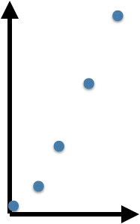
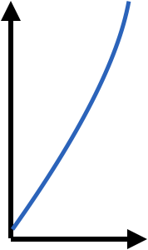
Tuesday: “Exploring Types of Models”
● Linear Regression
● Linear Regression Tutorial
● Mechanistic Modeling
● Mechanistic Modeling Tutorial
● Formulating Research Questions
● Epidemic Cards Game
Intro to Compartmental Models Introduction aux modèles compartimentés
Discrete time
Continuous time
population size, N_{t}
population size, N_{t}
time
time

Slide 22
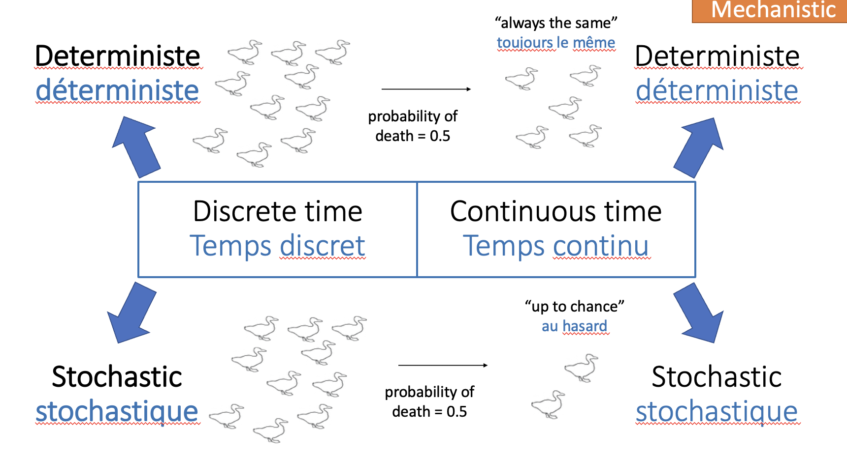
Intro to Compartmental Models Introduction aux modèles compartimentés
Tuesday: “Exploring Types of Models”
● Linear Regression
● Linear Regression Tutorial
● Mechanistic Modeling
● Mechanistic Modeling Tutorial
● Formulating Research Questions
● Epidemic Cards Game

Slide 23
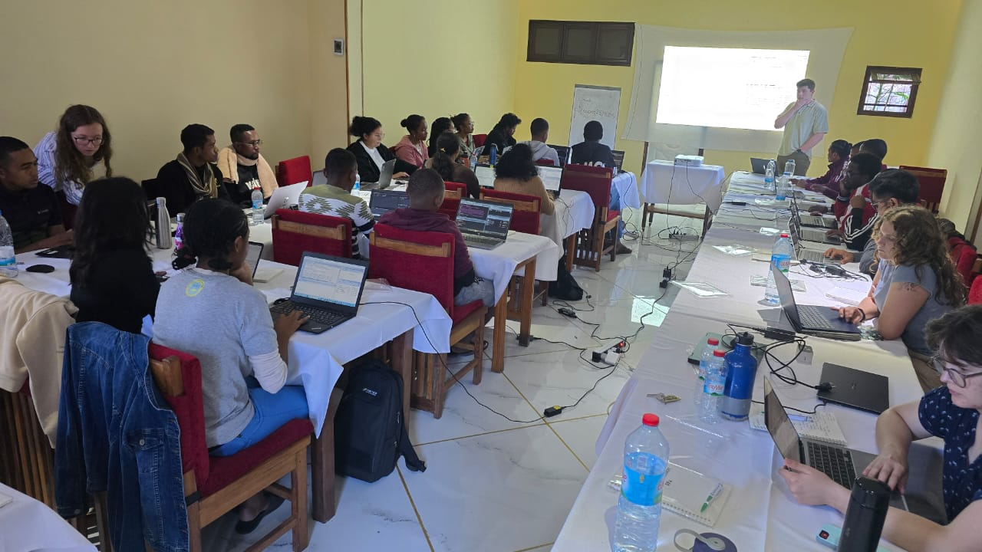
Refining research questions for modeling Affiner les questions de recherche pour la modélisation
Tuesday: “Exploring Types of Models”
● Linear Regression
● Linear Regression Tutorial
● Mechanistic Modeling
● Mechanistic Modeling Tutorial
● Formulating Research Questions
● Epidemic Cards Game

Slide 24
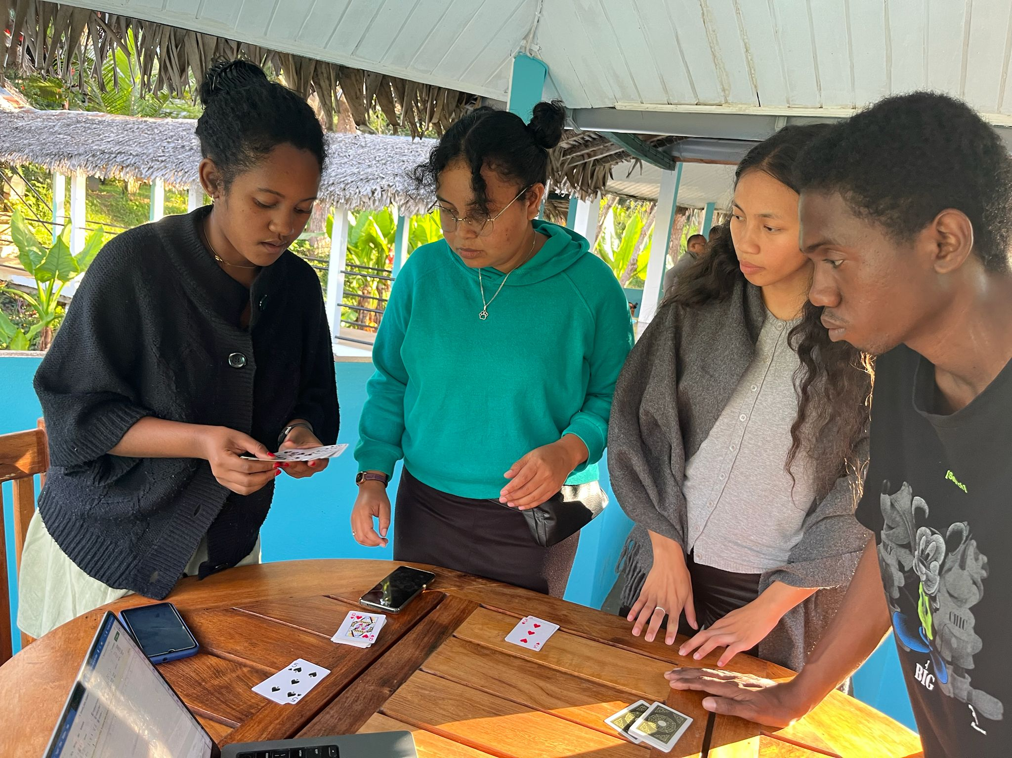
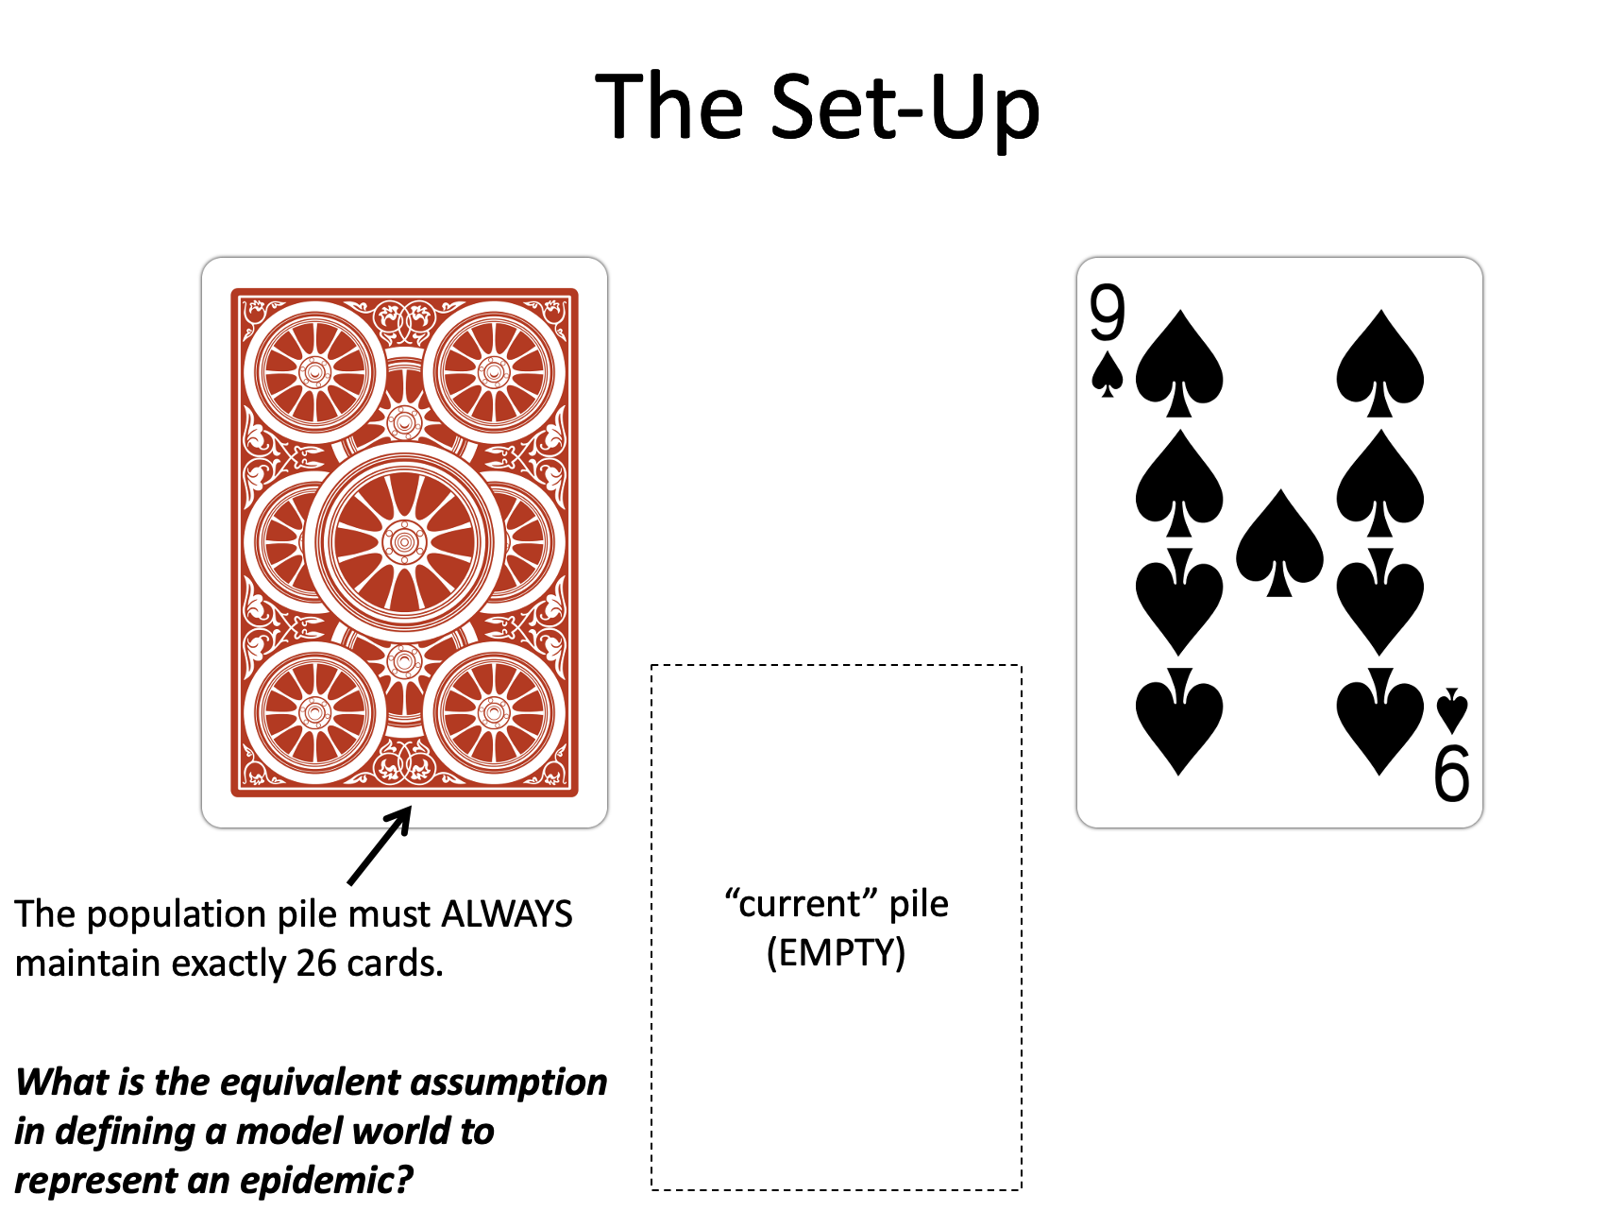
Epidemic Cards Cartes Épidémie
Tuesday: “Exploring Types of Models”
● Linear Regression
● Linear Regression Tutorial
● Mechanistic Modeling
● Mechanistic Modeling Tutorial
● Formulating Research Questions
● Epidemic Cards Game

Slide 25
Saturday: R Bootcamp
Intro to R and R Studio
Data Manipulation in R
Exploring and Visualizing Data in R
Wednesday: “Fitting Models to Data”
● Refining Research Questions for Modeling
● Reading a Model-Focused Research Paper
● Model Fitting in Practice
● Model Fitting Tutorial
● Model Fitting with Epidemic Cards
Sunday: “Travel Day”
● Travel MBC → Andasibe
● Downloading packages
● Night walk at VOI
Tuesday: “Exploring Types of Models”
● Linear Regression
● Linear Regression Tutorial
● Mechanistic Modeling
● Mechanistic Modeling Tutorial
● Formulating Research Questions
● Epidemic Cards Game
Monday: “Getting Started with the Basics”
● Data and Models
● Formulating Research Questions
● Simple Mathematics and Statistics
● Dynamical Fever

Slide 26
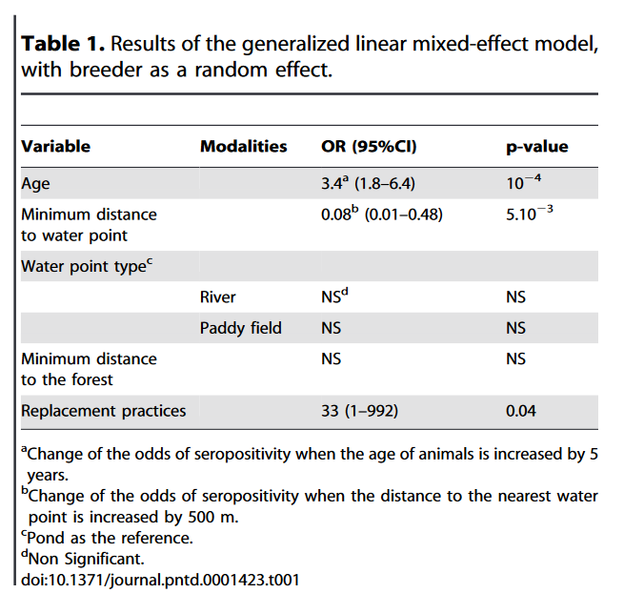
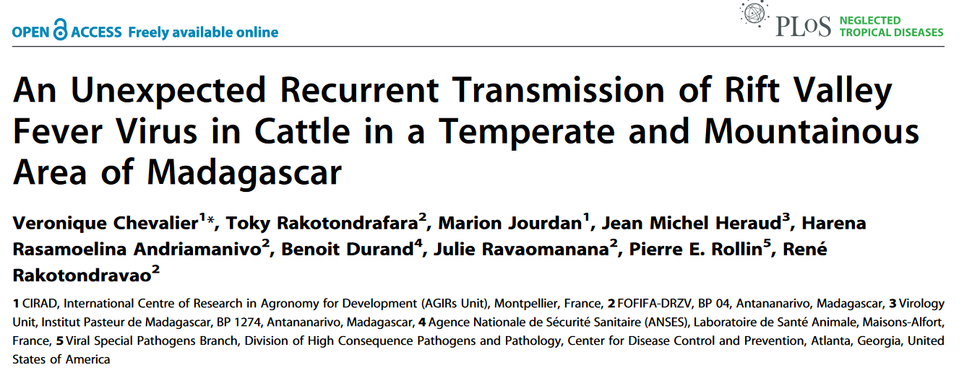
Reading a Research Paper Lire un article scientifique
Wednesday: “Fitting Models to Data”
● Refining Research Questions for Modeling
● Reading a Model-Focused Research Paper
● Model Fitting in Practice
● Model Fitting Tutorial
● Model Fitting with Epidemic Cards

Slide 27
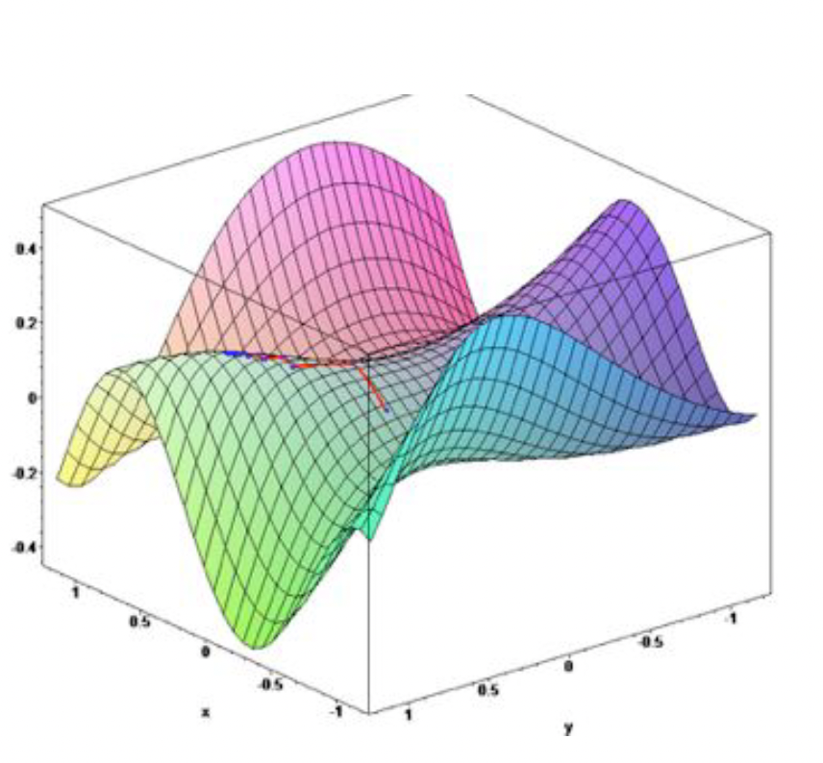
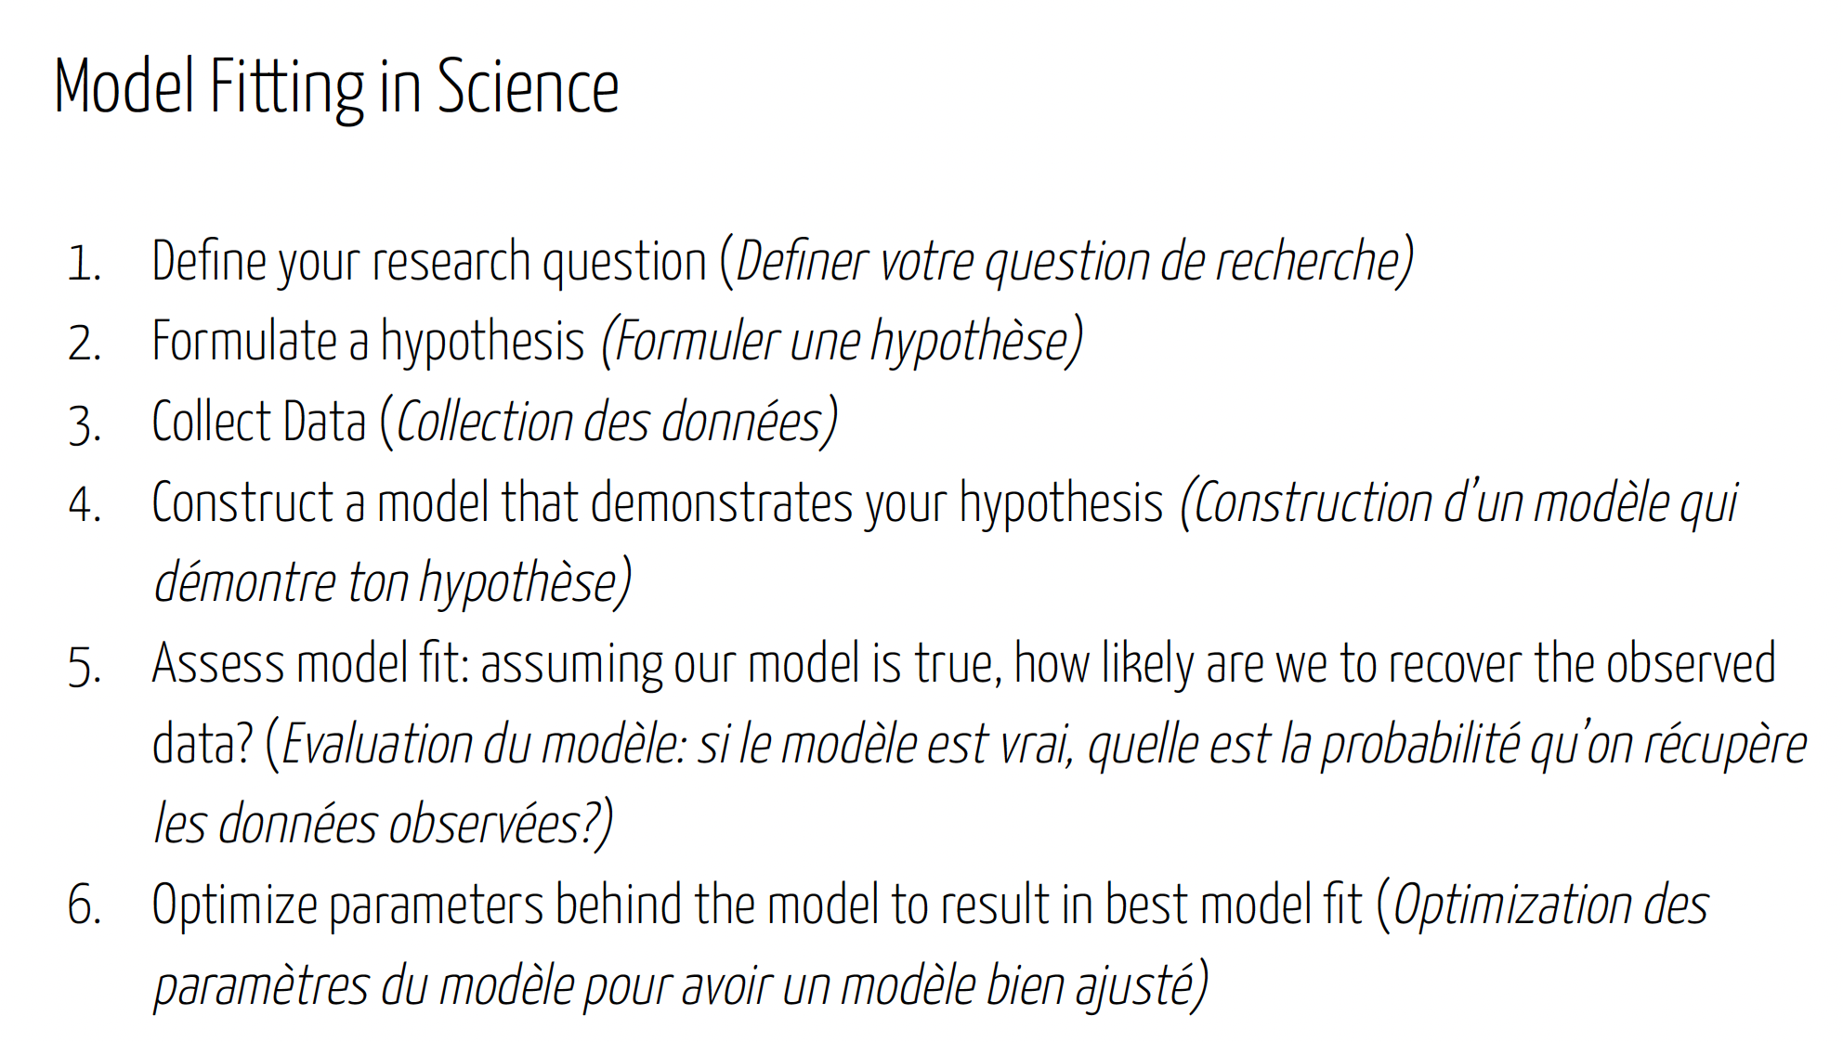
Fitting Models to Data Adapter les modèles aux données
Wednesday: “Fitting Models to Data”
● Refining Research Questions for Modeling
● Reading a Model-Focused Research Paper
● Model Fitting in Practice
● Model Fitting Tutorial
● Model Fitting with Epidemic Cards

Slide 28
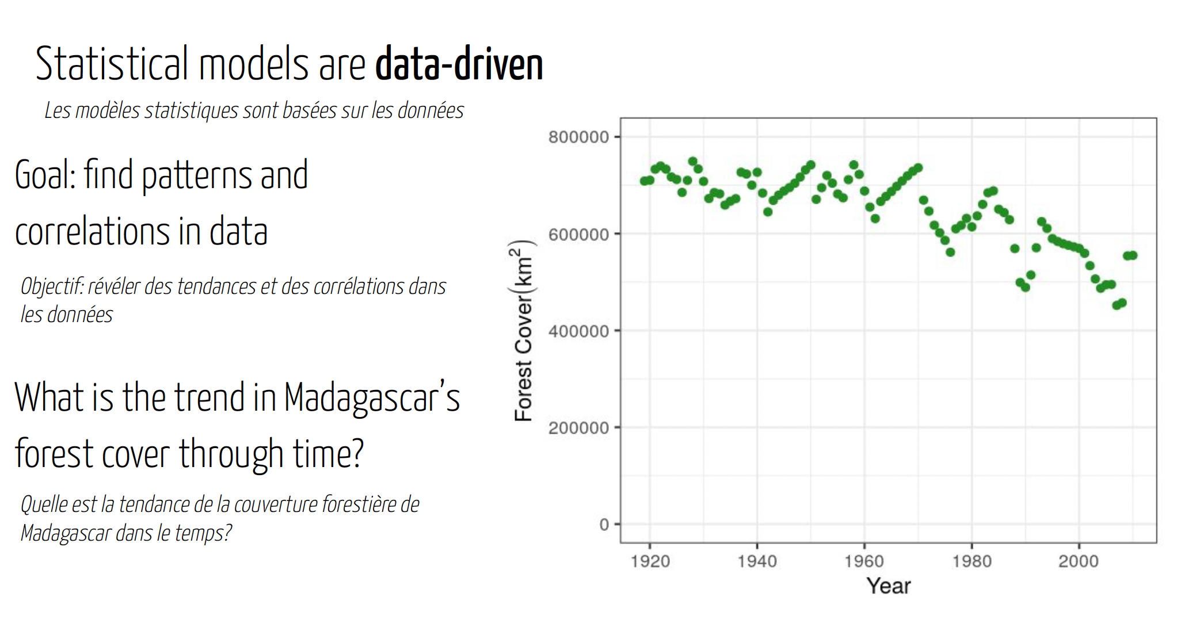
Fitting Models to Data Adapter les modèles aux données
Wednesday: “Fitting Models to Data”
● Refining Research Questions for Modeling
● Reading a Model-Focused Research Paper
● Model Fitting in Practice
● Model Fitting Tutorial
● Model Fitting with Epidemic Cards

Slide 29
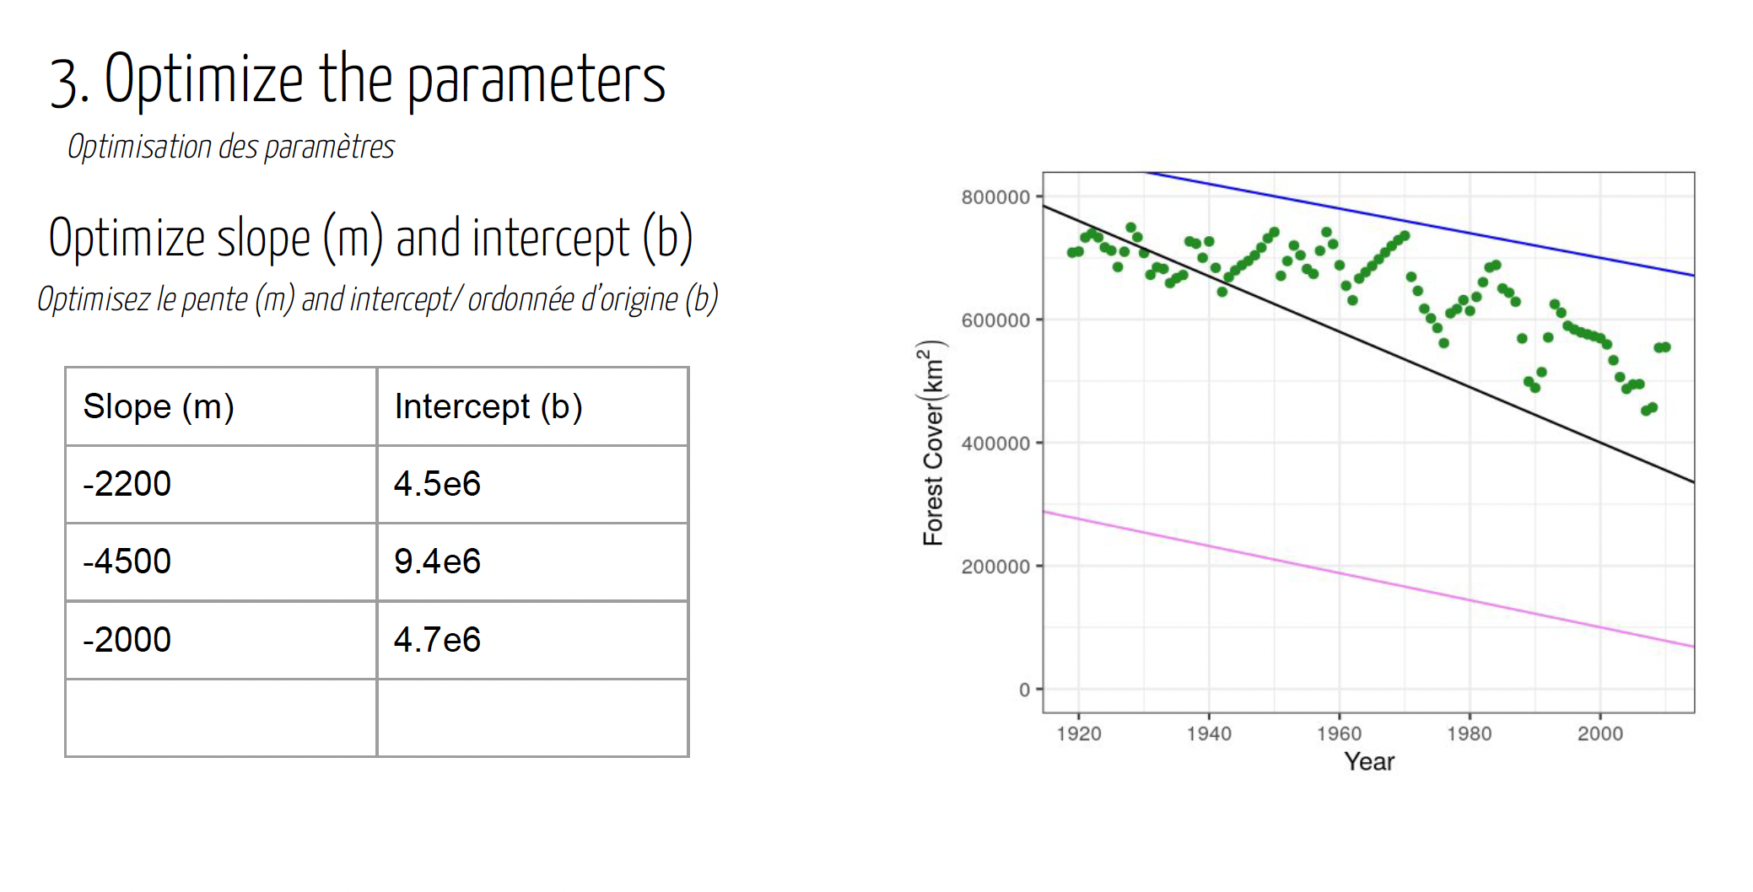
Fitting Models to Data Adapter les modèles aux données
Wednesday: “Fitting Models to Data”
● Refining Research Questions for Modeling
● Reading a Model-Focused Research Paper
● Model Fitting in Practice
● Model Fitting Tutorial
● Model Fitting with Epidemic Cards

Slide 30
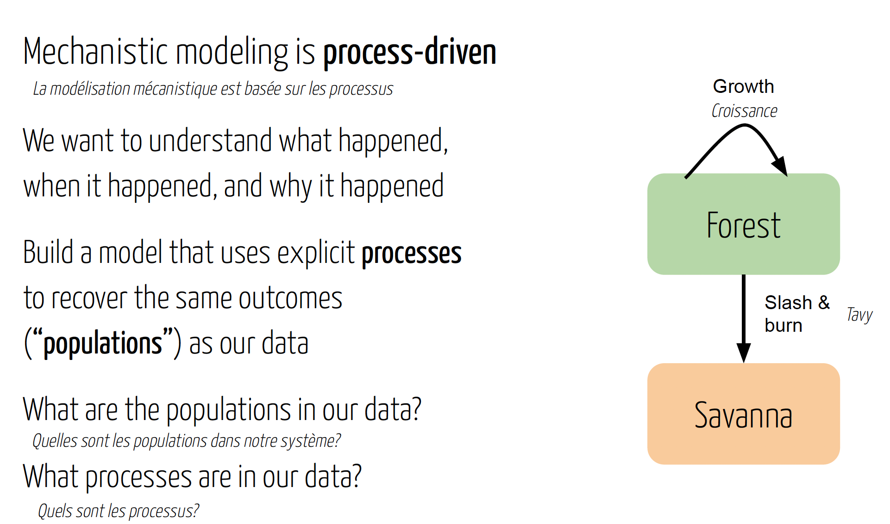
Fitting Models to Data Adapter les modèles aux données
Wednesday: “Fitting Models to Data”
● Refining Research Questions for Modeling
● Reading a Model-Focused Research Paper
● Model Fitting in Practice
● Model Fitting Tutorial
● Model Fitting with Epidemic Cards

Slide 31
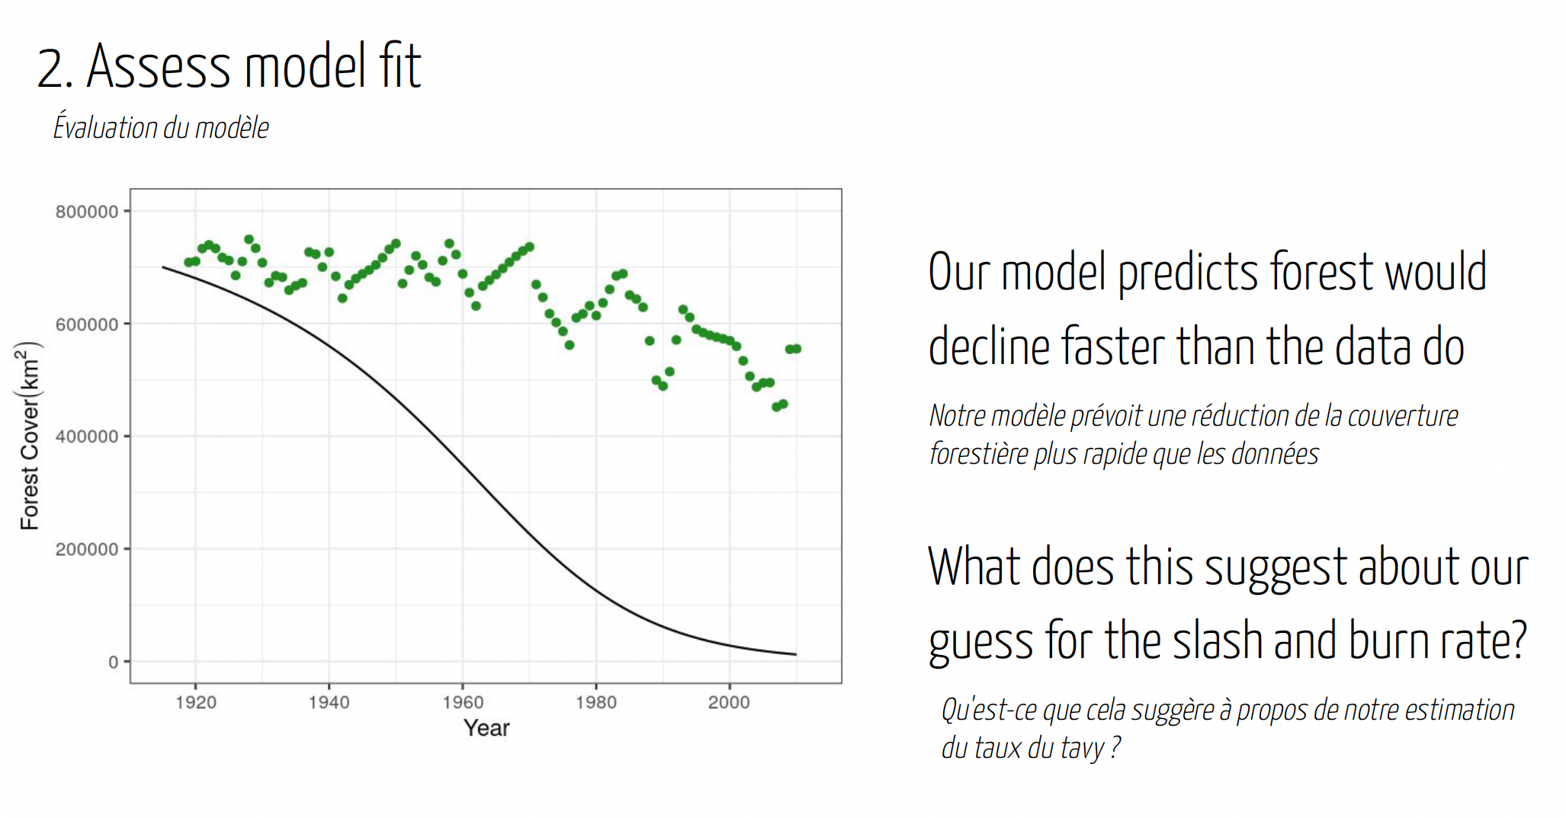
Fitting Models to Data Adapter les modèles aux données
Wednesday: “Fitting Models to Data”
● Refining Research Questions for Modeling
● Reading a Model-Focused Research Paper
● Model Fitting in Practice
● Model Fitting Tutorial
● Model Fitting with Epidemic Cards

Slide 32
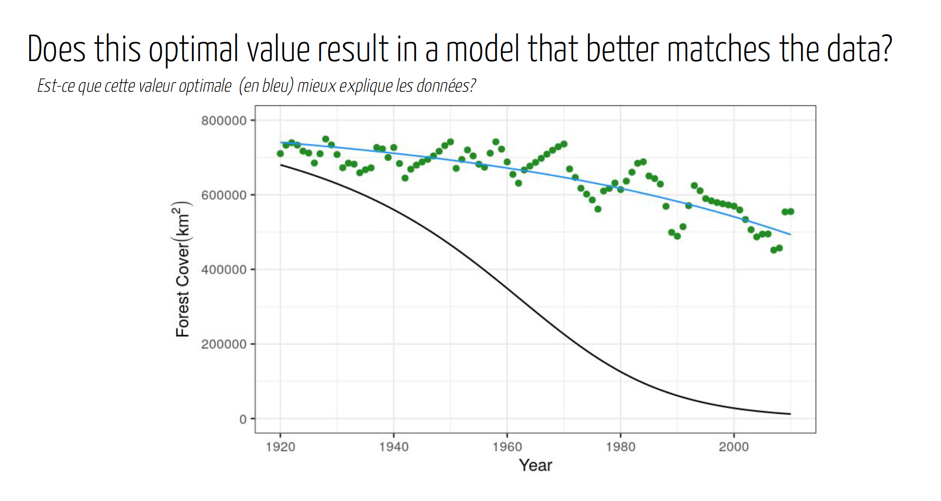
Fitting Models to Data Adapter les modèles aux données
Wednesday: “Fitting Models to Data”
● Refining Research Questions for Modeling
● Reading a Model-Focused Research Paper
● Model Fitting in Practice
● Model Fitting Tutorial
● Model Fitting with Epidemic Cards

Slide 33
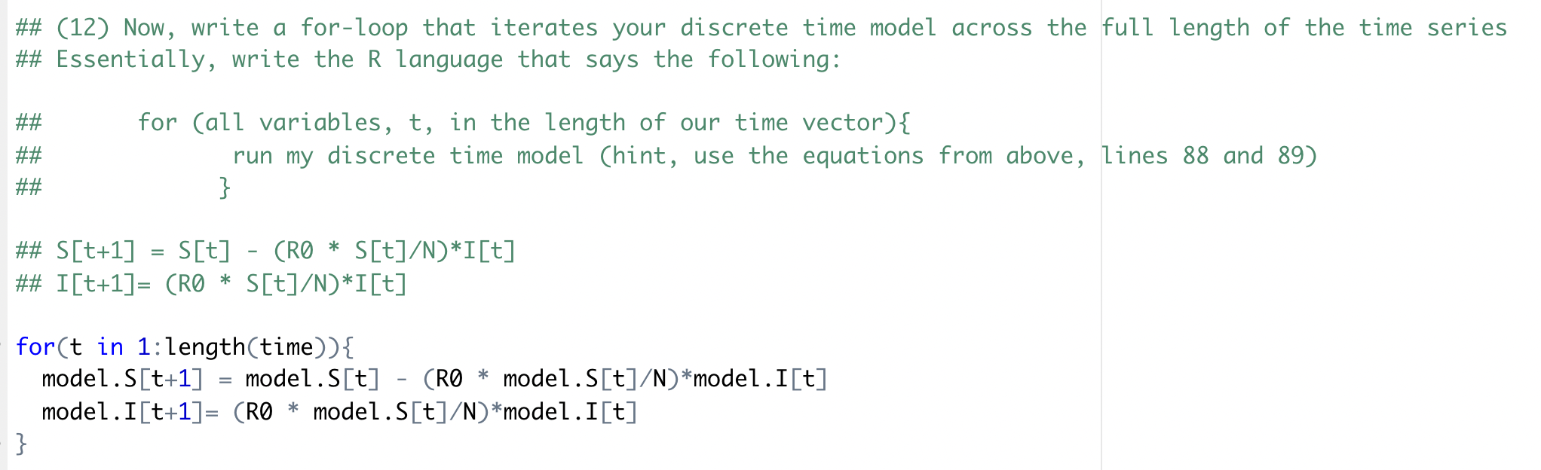
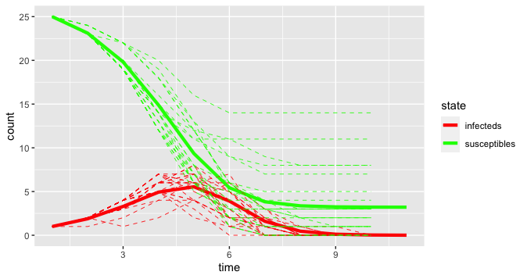
Model fitting with epidemic cards Adjuster les modèles : Cartes d’épidemie
Wednesday: “Fitting Models to Data”
● Refining Research Questions for Modeling
● Reading a Model-Focused Research Paper
● Model Fitting in Practice
● Model Fitting Tutorial
● Model Fitting with Epidemic Cards

Slide 34
Thursday: “Modeling Different Types of Data”
● Hike at VOI
● Spatial Analysis and Visualization
● Spatial Analysis Tutorial
● Model Comparison
Saturday: R Bootcamp
Intro to R and R Studio
Data Manipulation in R
Exploring and Visualizing Data in R
Wednesday: “Fitting Models to Data”
● Refining Research Questions for Modeling
● Reading a Model-Focused Research Paper
● Model Fitting in Practice
● Model Fitting Tutorial
● Model Fitting with Epidemic Cards
Sunday: “Travel Day”
● Travel MBC → Andasibe
● Downloading packages
● Night walk at VOI
Tuesday: “Exploring Types of Models”
● Linear Regression
● Linear Regression Tutorial
● Mechanistic Modeling
● Mechanistic Modeling Tutorial
● Formulating Research Questions
● Epidemic Cards Game
Monday: “Getting Started with the Basics”
● Data and Models
● Formulating Research Questions
● Simple Mathematics and Statistics
● Dynamical Fever

Slide 35
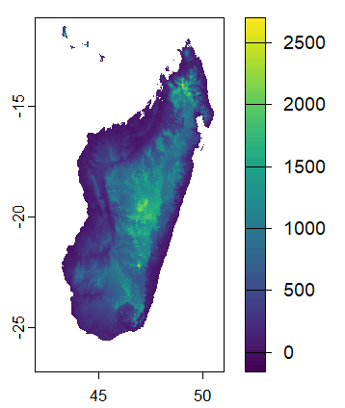
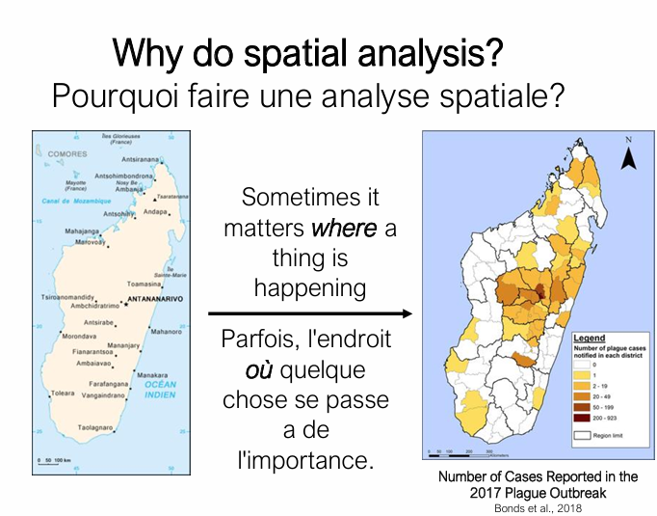
Spatial Analysis and Visualization L’analyse et la visualization spatiale
Thursday: “Modeling Different Types of Data”
● Hike at VOI
● Spatial Analysis and Visualization
● Spatial Analysis Tutorial
● Model Comparison

Slide 36
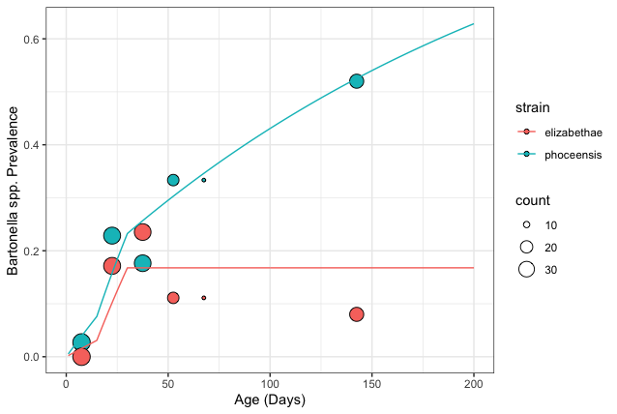
Model Selection and Comparison Sélection et comparaison de modèles
Thursday: “Modeling Different Types of Data”
● Hike at VOI
● Spatial Analysis and Visualization
● Spatial Analysis Tutorial
● Model Comparison
λ
S
I
λ
S
I
σ

Slide 37
Thursday: “Modeling Different Types of Data”
● Hike at VOI
● Spatial Analysis and Visualization
● Spatial Analysis Tutorial
● Model Comparison
Saturday: R Bootcamp
Intro to R and R Studio
Data Manipulation in R
Exploring and Visualizing Data in R
Wednesday: “Fitting Models to Data”
● Refining Research Questions for Modeling
● Reading a Model-Focused Research Paper
● Model Fitting in Practice
● Model Fitting Tutorial
● Model Fitting with Epidemic Cards
Sunday: “Travel Day”
● Travel MBC → Andasibe
● Downloading packages
● Night walk at VOI
Friday: “Using Models in Practice”
● Model Comparison Tutorial
● Phylogenetic Analysis
● Phylogenetic Analysis Tutorial
● Research Seminar
● Model Telephone
Tuesday: “Exploring Types of Models”
● Linear Regression
● Linear Regression Tutorial
● Mechanistic Modeling
● Mechanistic Modeling Tutorial
● Formulating Research Questions
● Epidemic Cards Game
Monday: “Getting Started with the Basics”
● Data and Models
● Formulating Research Questions
● Simple Mathematics and Statistics
● Dynamical Fever

Slide 38
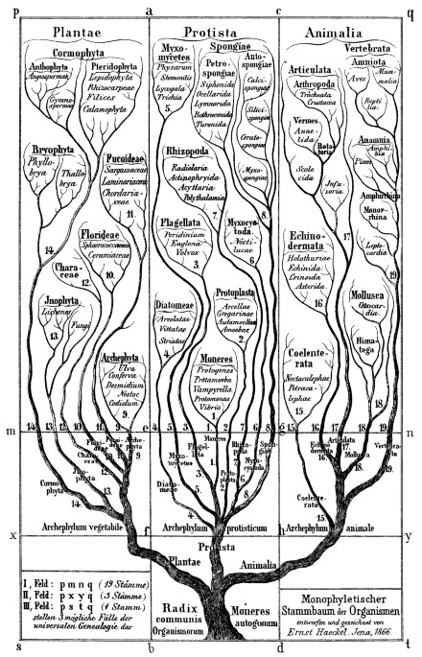
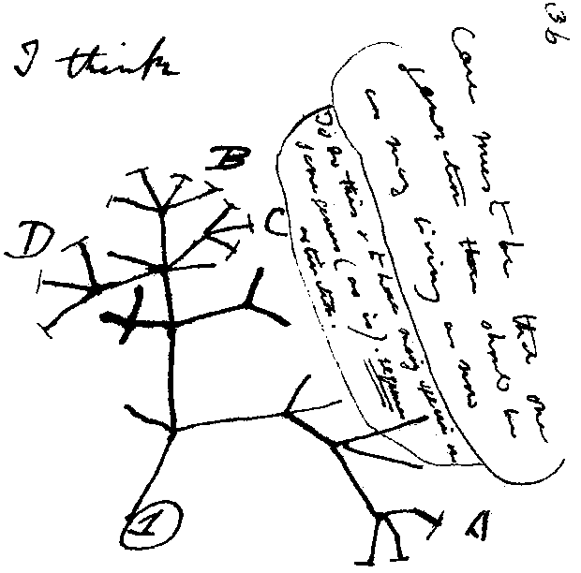
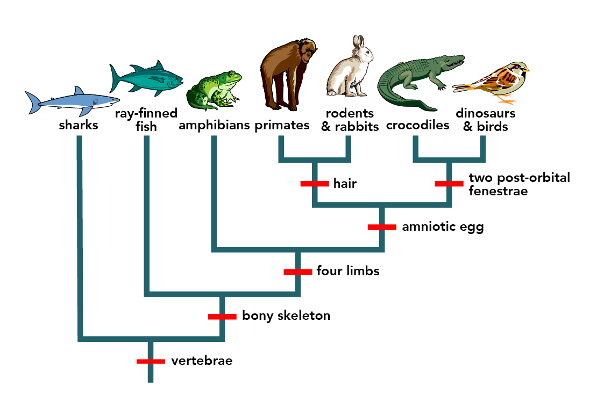
Intro to Phylogenetic Modeling Introduction à la modélisation phylogénétique
Friday: “Using Models in Practice”
● Model Comparison Tutorial
● Phylogenetic Analysis
● Phylogenetic Analysis Tutorial
● Research Seminar
● Model Telephone
Hossfeld and Levit, Nature, 2016

Slide 39
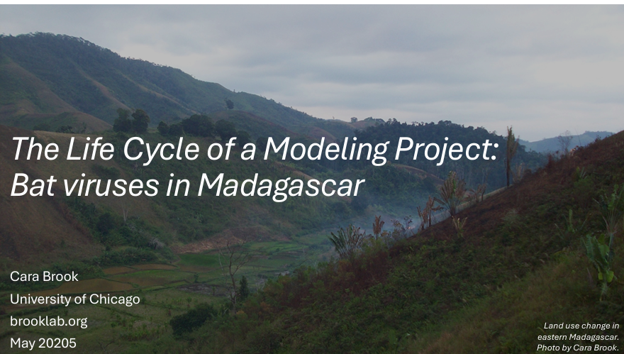
Research Seminar Presentation sur la recherche
Friday: “Using Models in Practice”
● Model Comparison Tutorial
● Phylogenetic Analysis
● Phylogenetic Analysis Tutorial
● Research Seminar
● Model Telephone

Slide 40
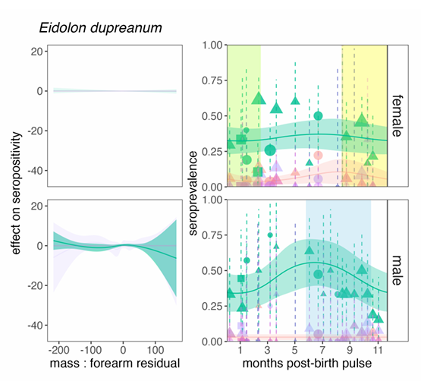
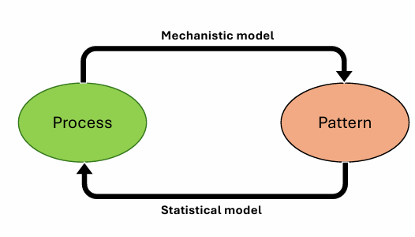
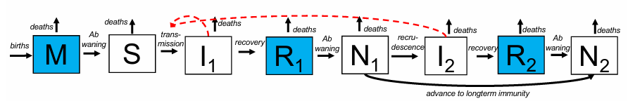
Research Seminar Presentation sur la recherche
Friday: “Using Models in Practice”
● Model Comparison Tutorial
● Phylogenetic Analysis
● Phylogenetic Analysis Tutorial
● Research Seminar
● Model Telephone

Slide 41
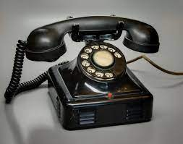
Model Telephone Modèle de téléphone
Friday: “Using Models in Practice”
● Model Comparison Tutorial
● Phylogenetic Analysis
● Phylogenetic Analysis Tutorial
● Research Seminar
● Model Telephone

Slide 42
● Programming
● Data
● Models
● Research Development
Thursday: “Modeling Different Types of Data”
● Hike at VOI
● Spatial Analysis and Visualization
● Spatial Analysis Tutorial
● Model Comparison
Saturday: R Bootcamp
Intro to R and R Studio
Data Manipulation in R
Exploring and Visualizing Data in R
Wednesday: “Fitting Models to Data”
● Refining Research Questions for Modeling
● Reading a Model-Focused Research Paper
● Model Fitting in Practice
● Model Fitting Tutorial
● Model Fitting with Epidemic Cards
Sunday: “Travel Day”
● Travel MBC → Andasibe
● Downloading packages
● Night walk at VOI
Friday: “Using Models in Practice”
● Model Comparison Tutorial
● Phylogenetic Analysis
● Phylogenetic Analysis Tutorial
● Research Seminar
● Model Telephone
Tuesday: “Exploring Types of Models”
● Linear Regression
● Linear Regression Tutorial
● Mechanistic Modeling
● Mechanistic Modeling Tutorial
● Formulating Research Questions
● Epidemic Cards Game
Monday: “Getting Started with the Basics”
● Data and Models
● Formulating Research Questions
● Simple Mathematics and Statistics
● Dynamical Fever
Saturday: Travel
Monday: “Sharing Your Work”
● Final student presentations

Slide 43
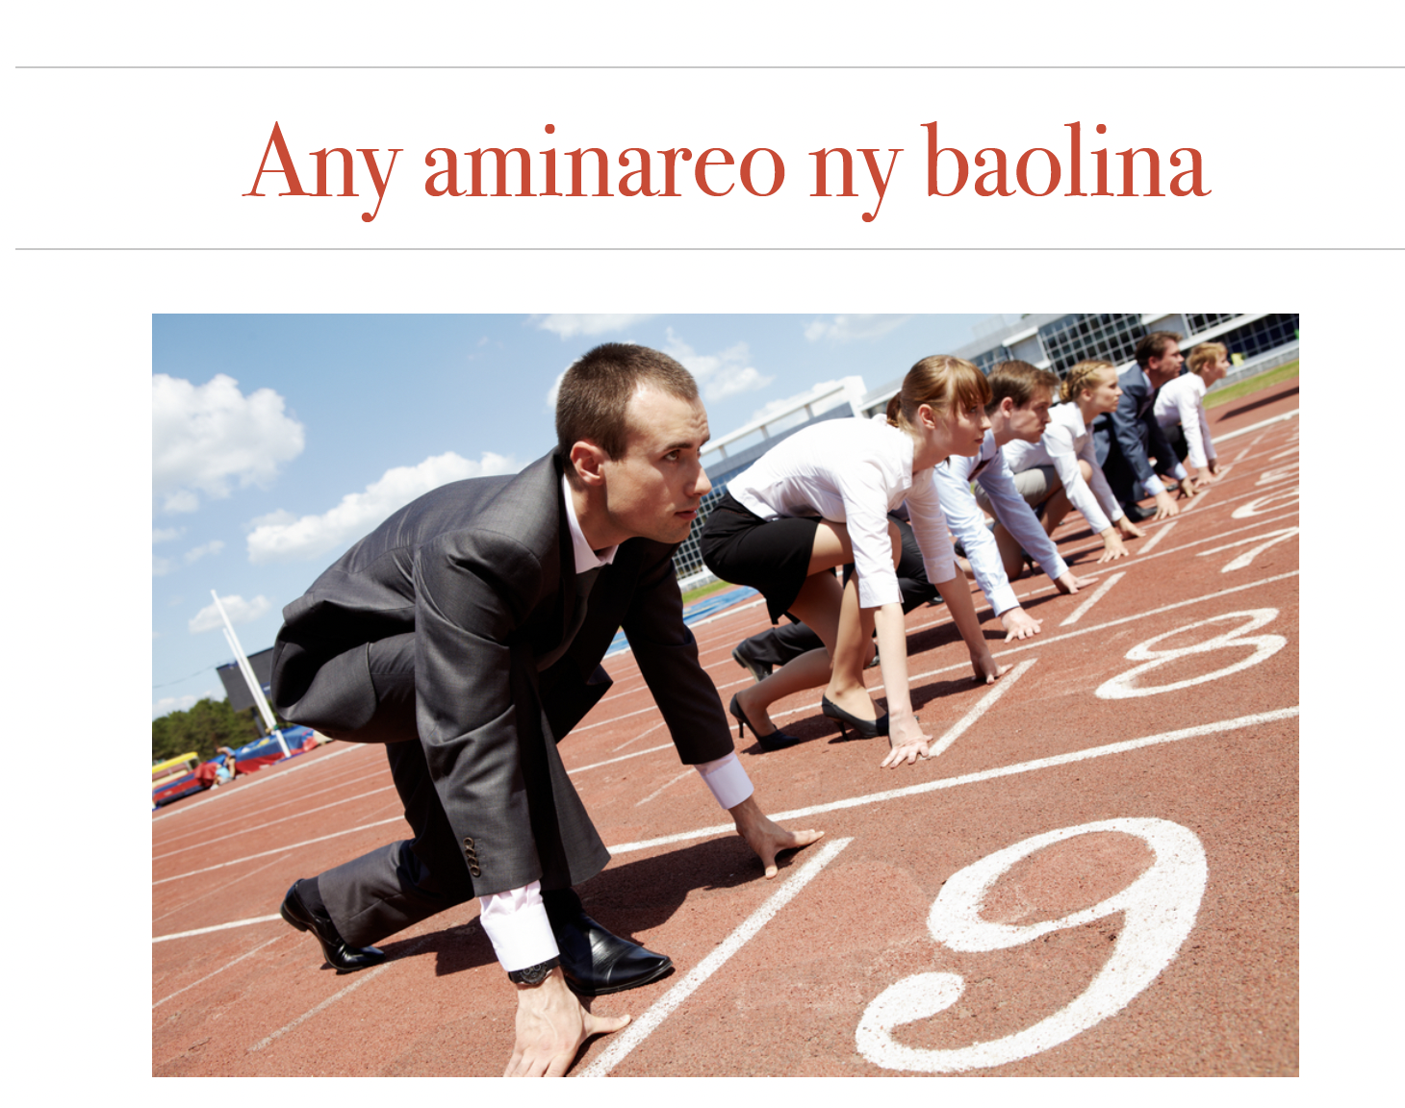

Slide 44
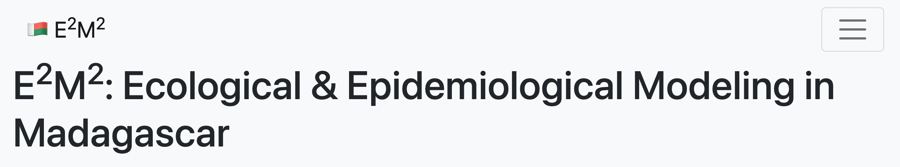
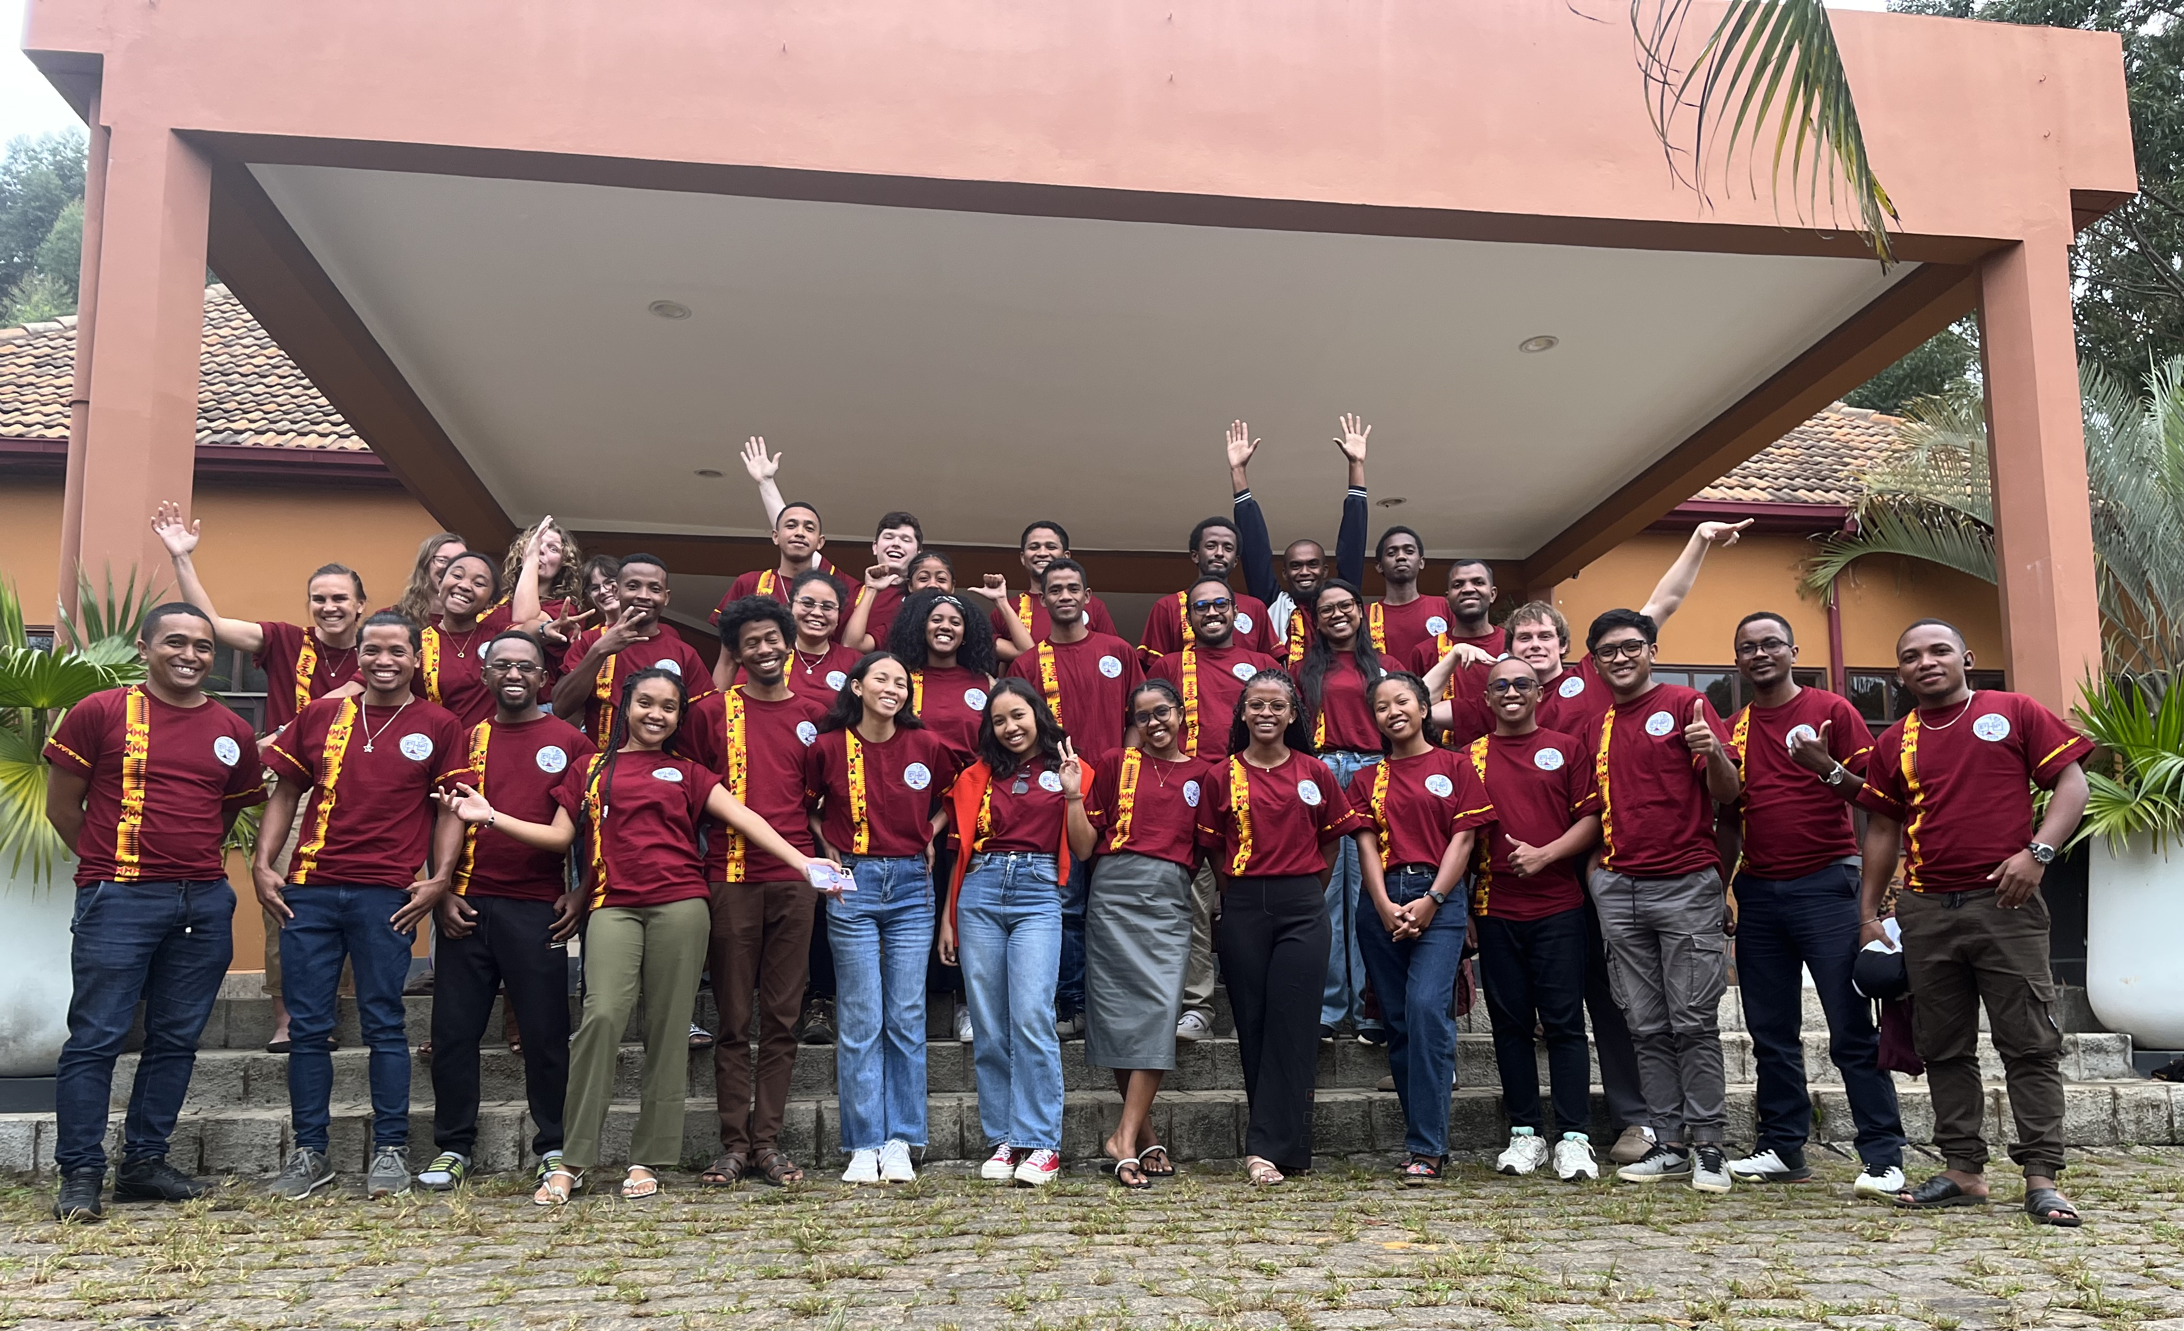

Slide 45
Schedule for the rest of the day:
Please bring your bags to the lobby before the end of coffee break
Bring the key to your room to Sophie during coffee break
One-on-One meetings will be held according to the schedule
Please come to lunch promptly at 12pm so we can have an on-time departure for Tana. We will leave immediately after lunch
Misaotra!

